Slide 1
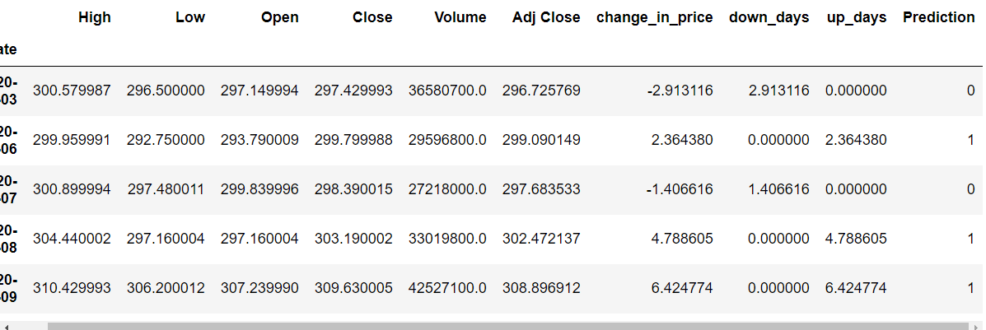
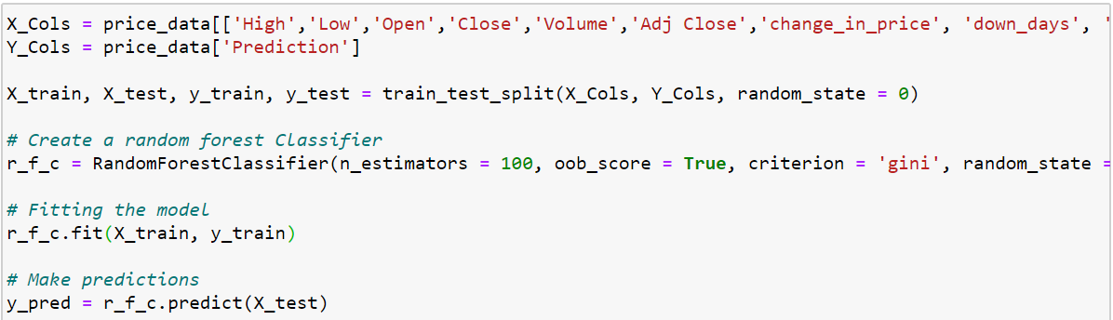
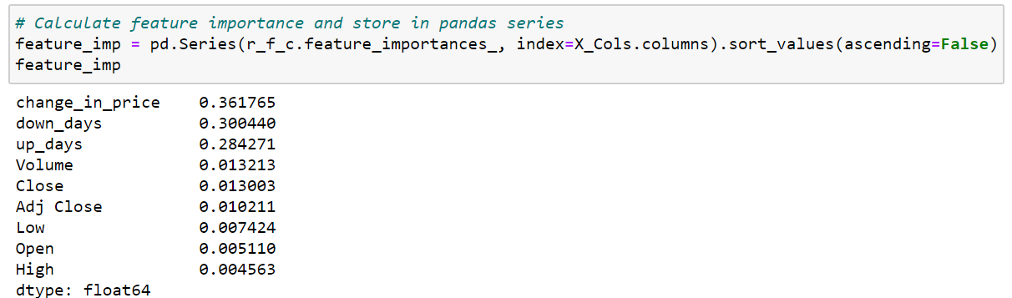
Random Forest –Model Details
Stock Used and Dates: Apple from 1/1/20 to 5/1/20
Added 4 new columns: ‘change_in_price’, ‘down_days’, ‘up_days’ and ‘Prediction’ – Based on prev. day close.
For ‘Prediction’: Looking to see the trend from prev. day
0 → Negative Down Day , 1 → Positive Up Day
Dropped NaN and split data into training and testing.
Create RandomForestClassifier, fit the model, and predict using X_test
Accuracy → number of accurate predictions model made on the test set. 95% is really good.
Just looking for direction of price trend. Not by how much price increased/decreased
Feature Importance → most import. features to explain most of model

Slide 2
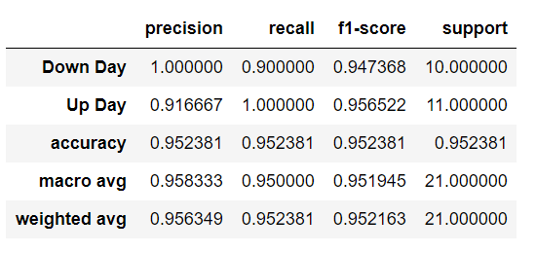
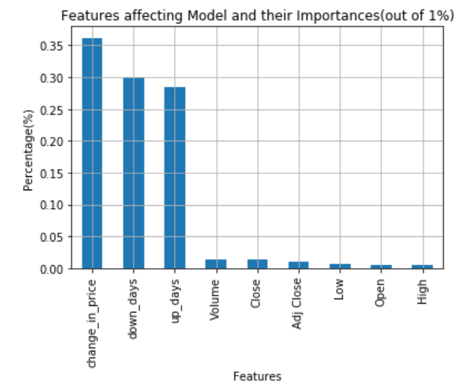
Random Forest - Model Findings
Classification Report metric evaluates model performance.
Accuracy – measures portion of all testing samples classified correctly.
**Precision → model was 100% correctly able to identify a negative down day
**Precision→ model was 91.6% correctly able to identify a positive up day.
Important Features and their percentages
Most important feature was ‘change_in_price’ column in affecting the model performance.
Least important feature was the ‘High’ column in affecting the model performance.
Able to draw conclusions about what features contribute most to the decision making in the model and help us better understand the drivers behind the model.

